Slide 1
Synchronization and desynchronization among regional business cycles
Makoto Muto (Graduate School of Business Administration, Hitotsubashi U., Japan)
Tamotsu Onozaki (Faculty of Economics, Rissho U., Japan)
Yoshitaka Saiki (Graduate School of Business Administration, Hitotsubashi U., Japan
and Japan Science & Technology Agency)
Outline
Introduction
Method: Hilbert transform, band-pass filter, synchronization index
Analysis: Synchronization analysis between Indices of industrial production data of Japan.
Conclusion

Slide 2
What is synchronization?
Multiple oscillations may synchronize if they directly interact with each other (e.g. Metronomes on a single board).
(https://youtu.be/Aaxw4zbULMs)
Southeast Asian fireflies within a given tree flash simultaneously without mutual direct interaction.
(https://youtu.be/dcKx9wlCfiQ)
⇓
Synchronization is the rhythm adjustment through interaction.
We study synchronization among the indices of industrial production (IIP) data.

Slide 3
Previous studies
Business cycle synchronization has become a topic of growing interest from around the end of the twentieth century.
Artis and Zhang (1999), Imbs (1999), Selover and Jensen (1999), etc.
Regional business cycle exhibits intermittent transition between synchronization and desynchronization of each regional fluctuations.
Savva et al. (2010), Hanus and Vacha(2016), etc.
According to cross-wavelet analysis of reginal business cycles , it is found that during the recession phase, the degree of synchronization is high and during the expansion phase, the degree is low.
Esashi, Onozaki and Saiki (in preparation)

Slide 4
Motivation
This study focuses on business cycles among regions in Japan.
Business cycles among regions may synchronize with each other.
Synchronization among regional business cycles will be a useful information for making economic policies.
We try to quantify the synchronization of regional business cycles using the method of synchronization analysis.

Slide 5
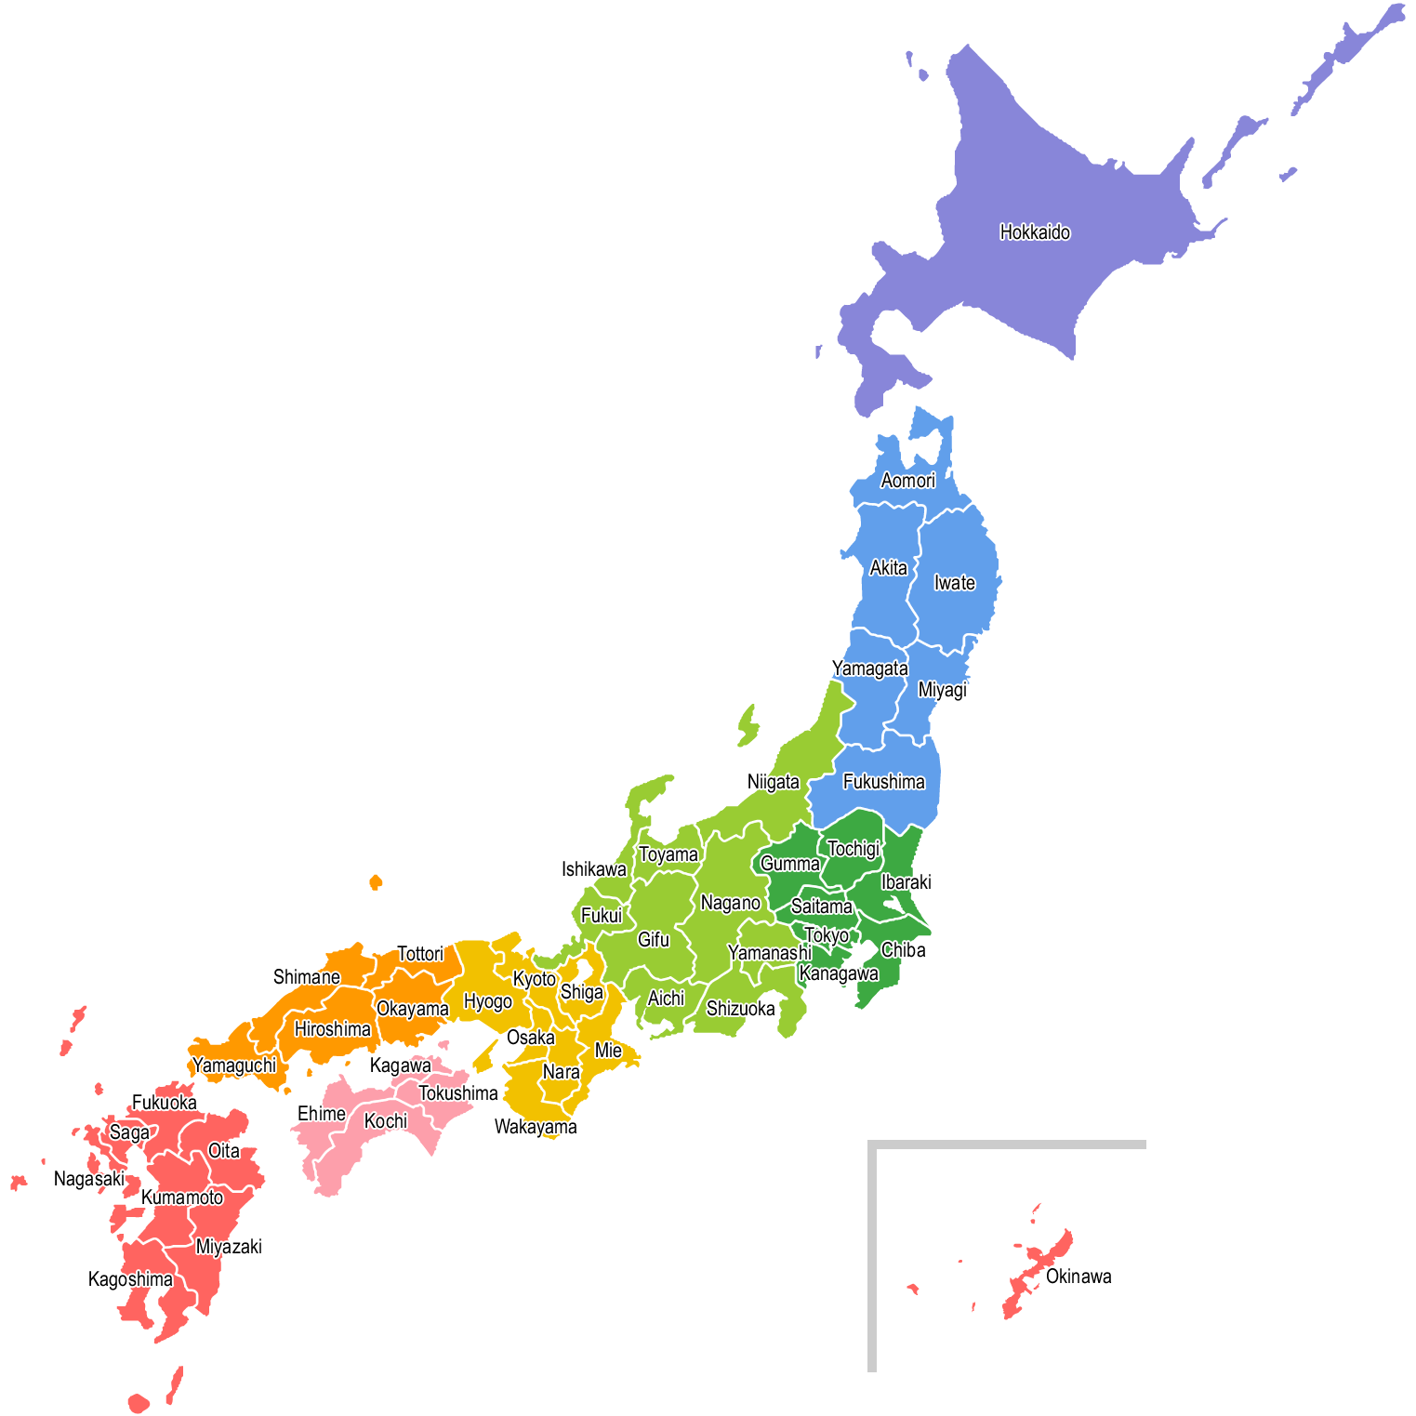
Purpose
Japan is composed of 47 prefectures.
We investigate the degree of synchronization among these prefectures in Japan.
TOKYO
KYOTO

Slide 6
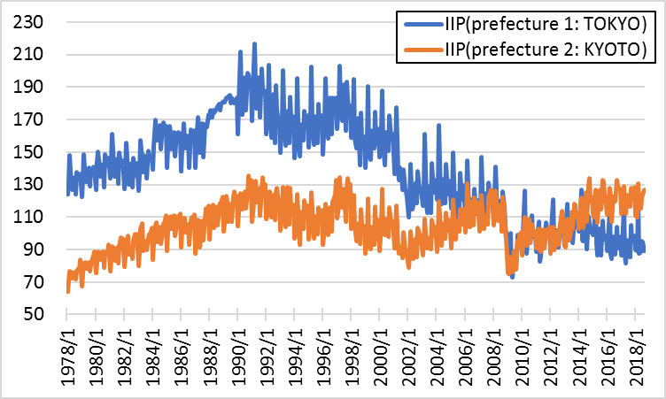
Data
Indices of industrial production (IIP) of 47 prefectures
1978.1-2018.8, Monthly data, 2010=100

Slide 7
Hypothesis
During economic expansion period
Fluctuations in production of regions tend to synchronize weakly.
During economic contraction period
Fluctuations in production of regions tend to synchronize strongly.
The hypothesis comes from our previous study.
Esashi ,Onozaki and Saiki (in preparation)

Slide 8
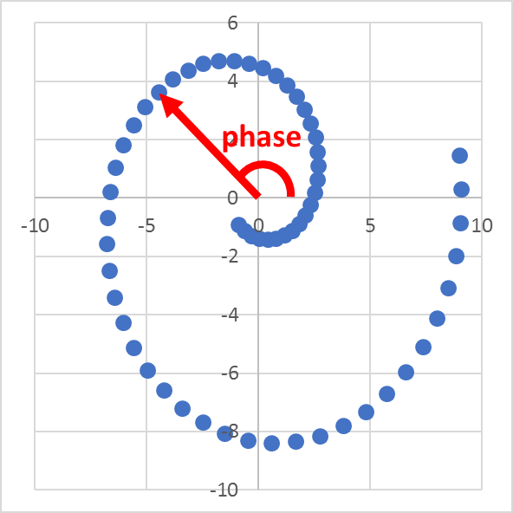
Phase
A phase can be defined as an angle formed by the horizontal axis and the 2-D data.
In order to capture synchronization, we use the notion of phase.

Slide 9
How to define a phase?
We say that two time series synchronize when the phase difference is constant in time.
⇓
To measure the phase difference, we need to define a phase.
⇓
We apply the Hilbert transform to an original 1-D data to create 2-D time series.

Slide 10
Hilbert transform
Hilbert transform
: time series data in period t
$P.V.$ : Cauchy principal value integrals.
The Hilbert transform creates “π/2 phase delayed” data.

Slide 11
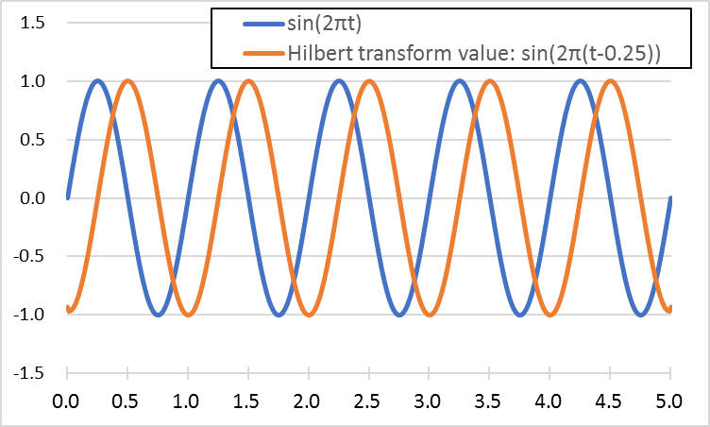
Hilbert transform
Blue line is $s_{t}=$ sin(2πt) (t = 0.00, 0.01, …).
Orange line is Hilbert transform value $s_{t}^{H}=$(sin(2π(t-0.25))) of sin(2πt).

Slide 12
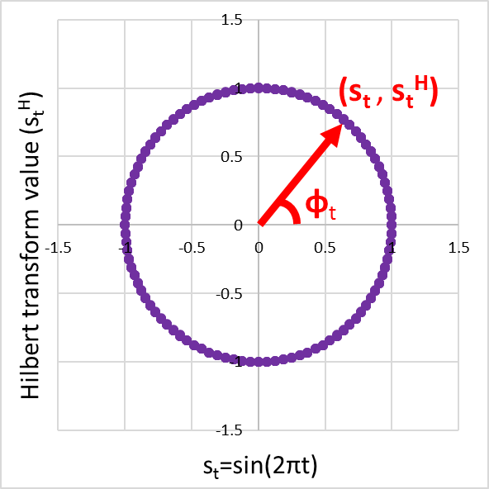
Instantaneous phase
Define a phase using Hilbert transform.
2-D data
Horizontal axis: original data ($s_{t}$=sin(2πt))
Vertical axis: Hilbert transform value
($s_{t}^{H}$=sin(2π(t-0.25)))
The phase is defined by the angle φ formed by the horizontal axis and the 2-D data
($s_{t}$, $s_{t}^{H}$).

Slide 13
Phase difference analysis
We say that two time series synchronize when the phase difference is constant in time (“$φ_{t}^{1}−φ_{t}^{2}$” ≈ const.).

Slide 14
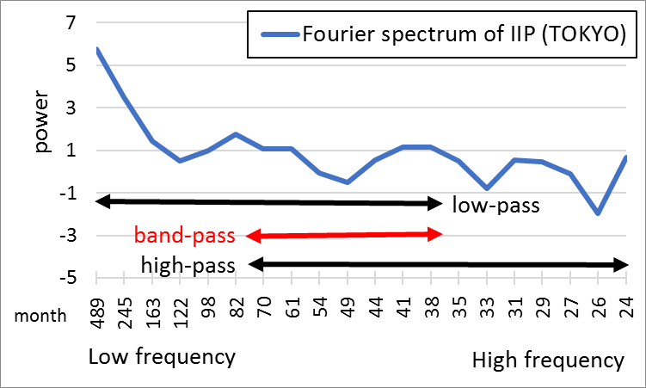
Choice of frequency band from the power spectrum

Slide 15
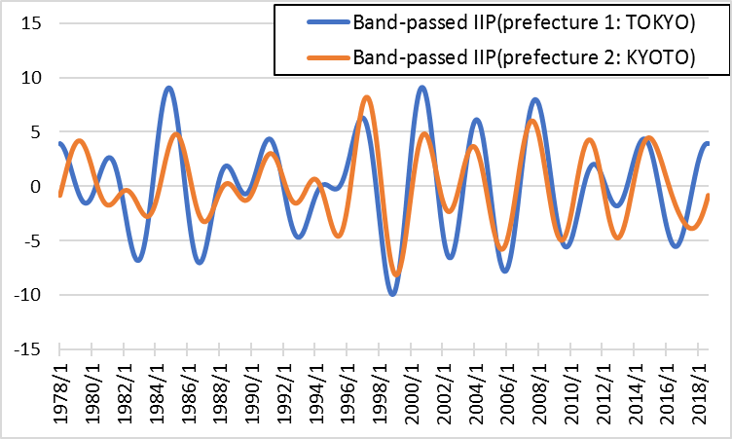
Band-pass filter
The band used in this study refers to the length of Japanese business cycle determined by the Japanese Cabinet Office.
Band-pass filtered IIP data (from 35 to 81 months)
Band-pass filter

Slide 16
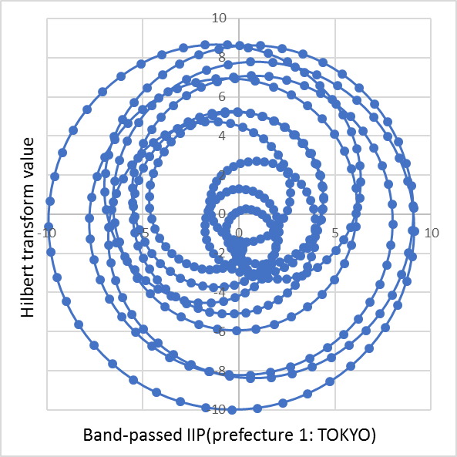
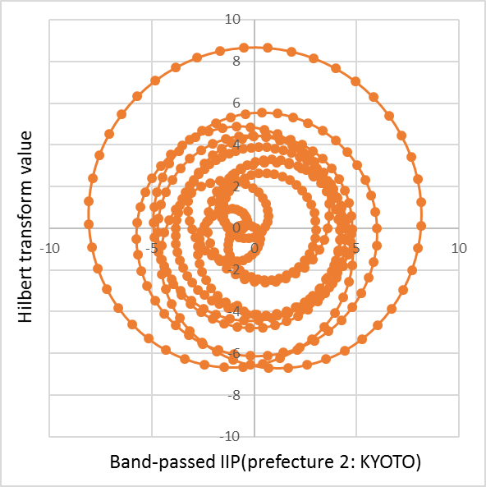
Instantaneous phase
2-D data of band-pass filtered IIP data
TOKYO
KYOTO

Slide 17
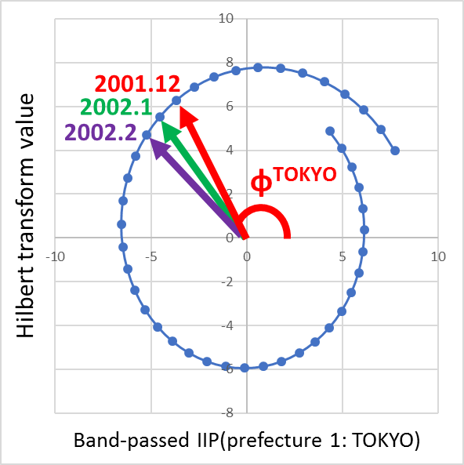
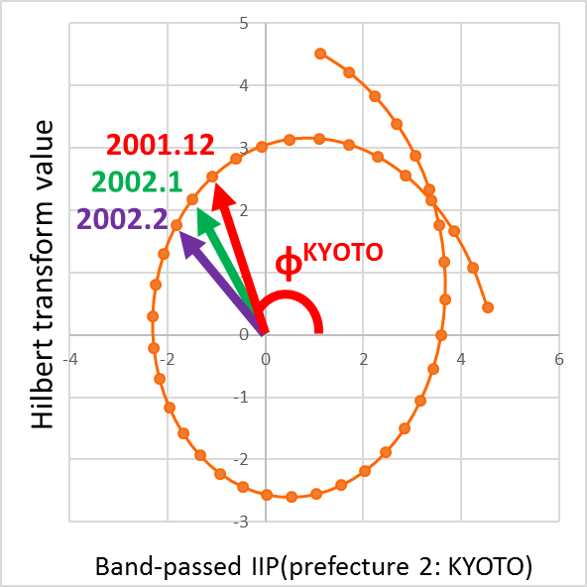
Instantaneous phase
2-D data of band-pass filtered IIP data from January 2001 to July 2004.
TOKYO
KYOTO

Slide 18
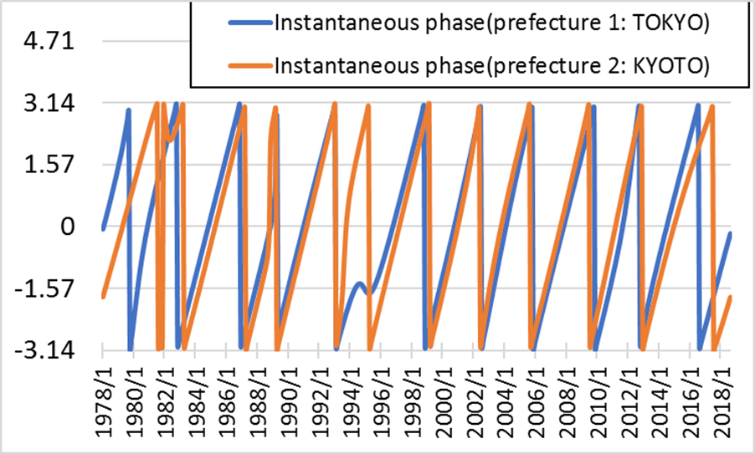
Instantaneous phase
Instantaneous phase of IIP data
The phase difference of two time series is constant in some intervals.(red)→Tokyo and Kyoto economies synchronize in these intervals.

Slide 19
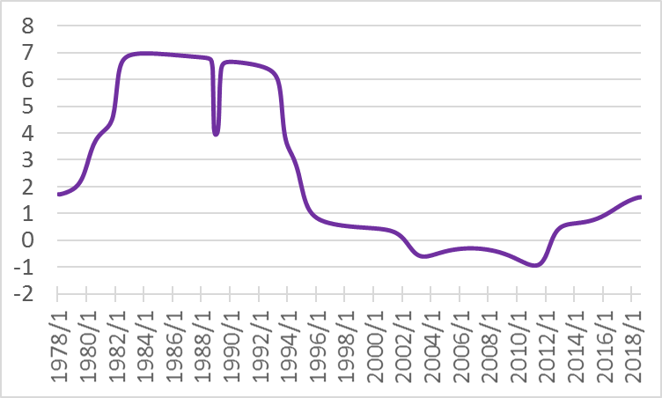
Phase difference (Tokyo and Kyoto)
The phase difference between Tokyo and Kyoto IIPs.
In flat periods(red), IIPs of Tokyo and Kyoto synchronize.

Slide 20
Phase difference analysis
A phase difference is expressed as
$$ψ_{t}={\hat{φ}}_{t}^{1}−{\hat{φ}}_{t}^{2}$$
${\hat{φ}}_{t}^{n}$: (unwrap) instantaneous phase for n-th data
When two time series synchronize, $ψ_{t}$ satisfies
$$\left|ψ_{t}−d\right|<c$$
$d$: constant
$c$: sufficiently small positive constant

Slide 21
Rosenblum et al. (2001)
Quantify the degree of synchronization.
Synchronization index
$$γ^{2}={\left(\frac{1}{w}\sum_{i=s}^{s+w}{cosψ_{i}}\right)}^{2}+{\left(\frac{1}{w}\sum_{i=s}^{s+w}{sinψ_{i}}\right)}^{2}$$
$w$: period.
If $γ^{2}$ is close to 1, the degree of synchronization is high.
If $γ^{2}$ is close to 0, the degree of synchronization is low.

Slide 22
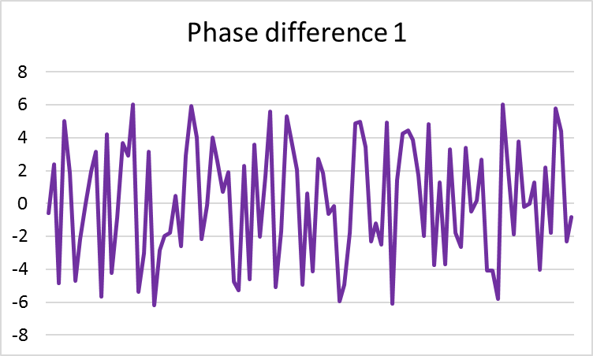
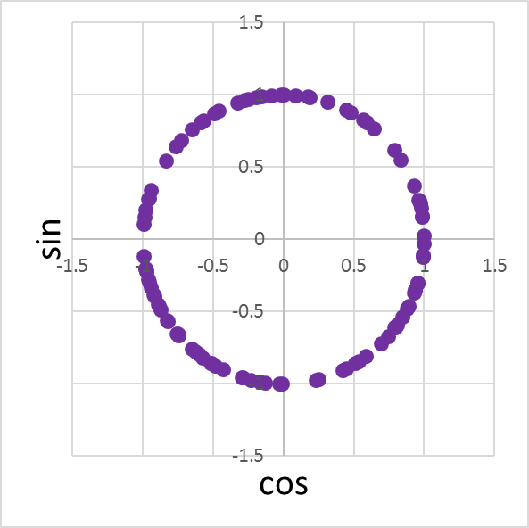
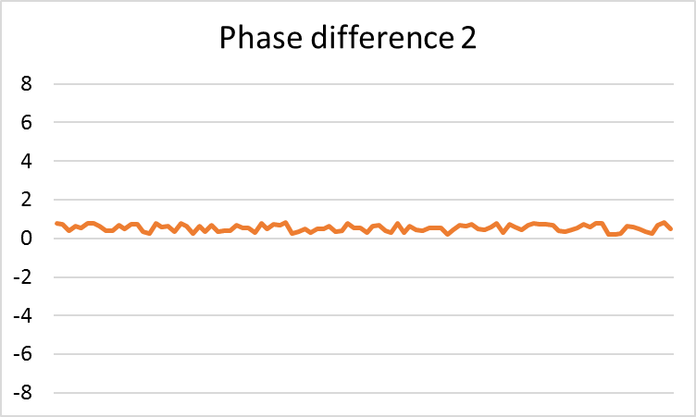
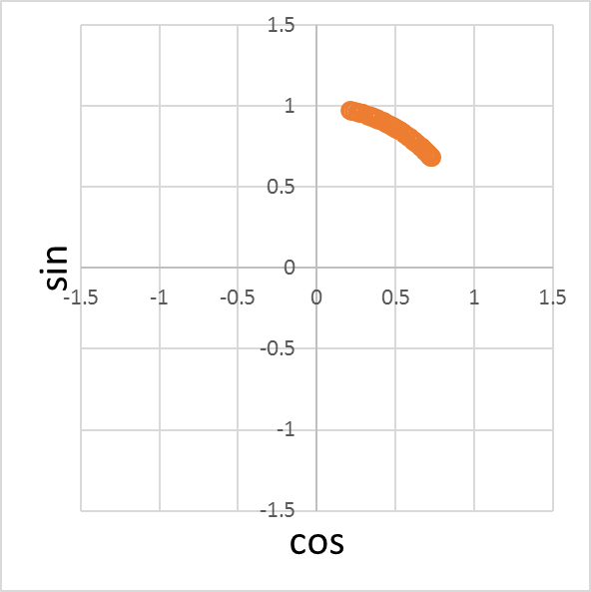
Phase difference and synchronization index
synchronization index = 0.01
synchronization index = 0.97

Slide 23
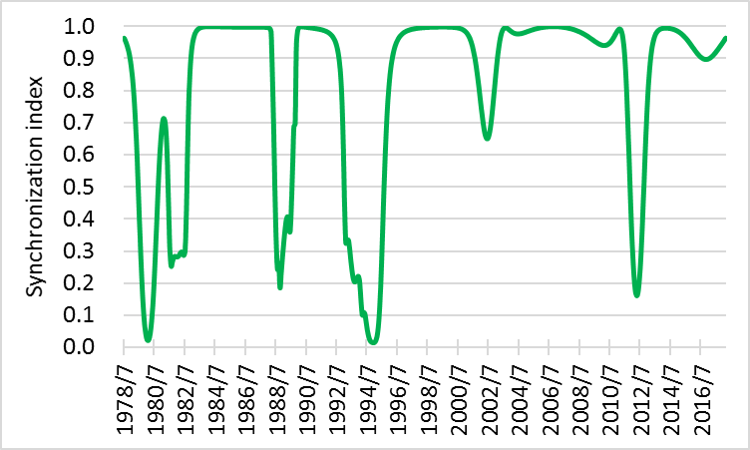
Synchronization index
Synchronization index between Tokyo and Kyoto.

Slide 24
Synchronization index
When the synchronization indices are close to 1,
the degree of synchronization is high.

Slide 25
Synchronization index
When the synchronization indices are close to 0,
the degree of synchronization is low.

Slide 26
Business cycle and synchronization
We obtain 1081 (=₄₇C₂) synchronization indices between any combination of prefectures in Japan.
Plot the number out of 1081 at which the synchronization index ≥ c
(threshold : c = 0.5, 0.6, 0.7, 0.8, 0.9)
During economic expansion period
→Fluctuations in production of regions tend to synchronize weakly. (⇔The number over the threshold is small.)
During economic contraction period
→Fluctuations in production of regions tend to synchronize strongly. (⇔The number over the threshold is large.)

Slide 27
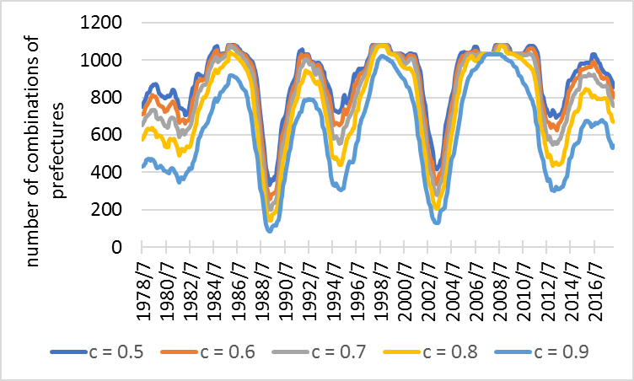
Synchronization index ≥ c

Slide 28
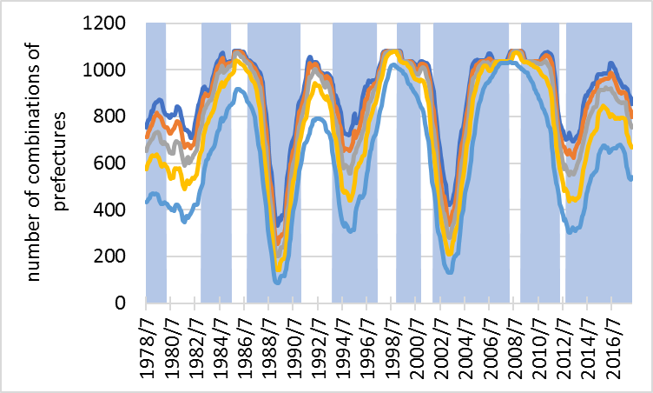
Synchronization index ≥ c
Blue intervals correspond to economic expansion periods.
The number over the threshold tends to be small.
→In these periods, IIP of prefectures desynchronize.(red)

Slide 29
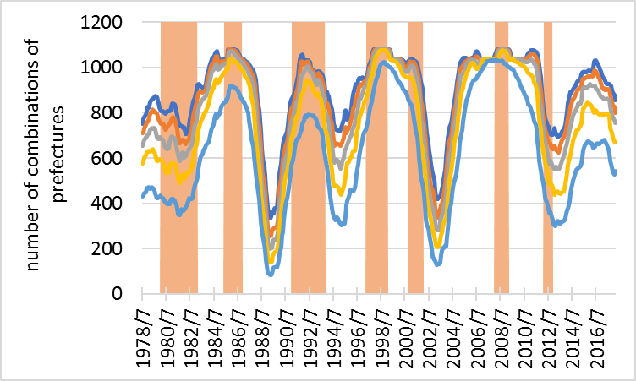
Synchronization index ≥ c
Orange intervals correspond to economic contraction periods.
The number over the threshold tends to be large.
→In these periods, IIP of prefectures synchronize.(red)

Slide 30
Conclusion
Synchronization of business fluctuations of regions is observed during economic contraction period.
Desynchronization of business fluctuations of regions is observed during economic expansion period.
These results are consistent with our previous study using the cross-wavelet transform.

Slide 31
References
Artis, M.J., Zhang, W., (1999). Further evidence on the international business cycleand the ERM: is there a European business cycle? Oxf. Econ. Pap. 51, 120–132.
Esashi, K., Onozaki, T., Saiki, Y., & Sato, Y. (2018). Intermittent transition between synchronization and desynchronization in multi-regional business cycles. Structural Change and Economic Dynamics, 44, 68-76.
Hanus, L., Vacha, L., (2016). Business Cycle Synchronization within the EuropeanUnion: A Wavelet Cohesion Approach. arXiv:1506.03106 [q-fin.EC].
Ikeda, Y., Aoyama, H., Iyetomi, H., and Yoshikawa, H. (2013). Direct evidence for synchronization in Japanese business cycles. Evolutionary and Institutional Economics Review, 10(2), 315-327.
Imbs, J., (1999). Co-Fluctuations. Center for Economic Policy Research, DiscussionPaper No. 2267 (Revised 2003).
Ju, K., Zhou, D., Zhou, P., and Wu, J. (2014). Macroeconomic effects of oil price shocks in China: An empirical study based on Hilbert–Huang transform and event study. Applied Energy, 136, 1053-1066
Kichikawa, Y., Iyetomi, H., Aoyama, H., and Yoshikawa, H. (2018). Empirical Evidence for Collective Motion of Prices with Macroeconomic Indicators in Japan. RIETI Discussion Paper Series.
Pikovsky, A., Rosenblum, M., Kurths, J., & Kurths, J. (2003). Synchronization: a universal concept in nonlinear sciences (Vol. 12). Cambridge university press.
Rodriguez, E., George, N., Lachaux, J. P., Martinerie, J., Renault, B., & Varela, F. J. (1999). Perception's shadow: long-distance synchronization of human brain activity. Nature, 397(6718), 430.
Rosenblum, M., Pikovsky, A., Kurths, J., Schäfer, C., and Tass, P. A. (2001). Phase synchronization: from theory to data analysis. In Handbook of biological physics (Vol. 4, pp. 279-321). North-Holland.
Savva, C.S., Neanidis, K.C., Osborn, D.R., (2010). Business cycle synchronization of theeuro area with the new and negotiating member countries. Int. J. Finance Econ.15, 288–306.
Selover, D.D., Jensen, R.V., (1999). ‘Mode-locking’ and international business cycletransmission. J. Econ. Dyn. Control 23, 591–618.
Varela, F., Lachaux, J. P., Rodriguez, E., and Martinerie, J. (2001). The brainweb: phase synchronization and large-scale integration. Nature reviews neuroscience, 2(4), 229.

Slide 32
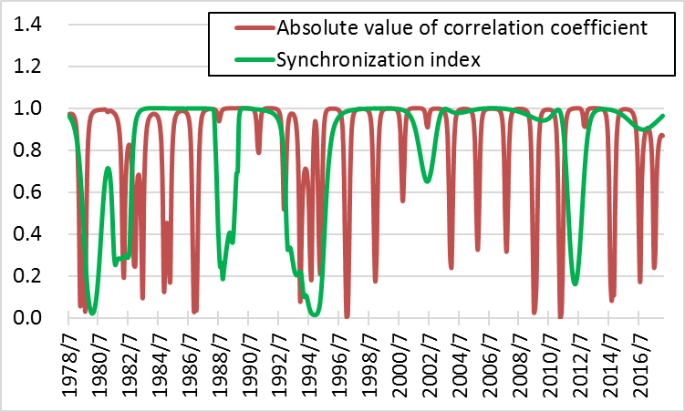
Comparison with correlation coefficient
The red line is the absolute value of correlation coefficient.
The green line is the synchronization index.

Slide 33
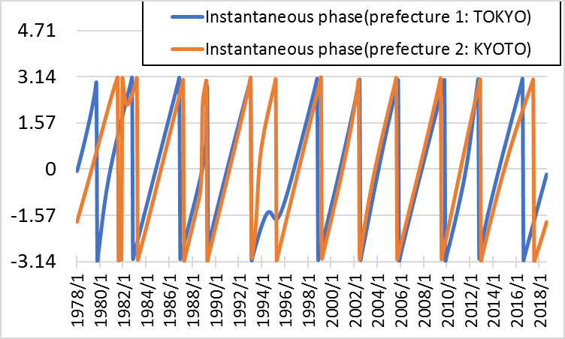
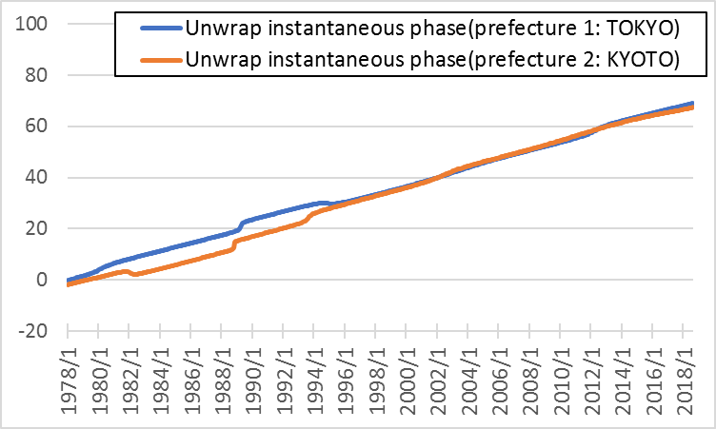
Unwrap Instantaneous phase
The instantaneous phase is difficult to use because it jumps at -π and π.
Use the unwrap instantaneous phase connected by -π and π.
Unwrap

Slide 34
Instantaneous phase
Define the instantaneous phase as follows:
Since value range of the instantaneous phase is $(−π, π)$.

Slide 35
Hilbert transform
Analytic signal
$$z_{t}=s_{t}+is_{t}^{H}$$
Fourier transform $Fz_{t}(f)$ of signal $z_{t}$
$$Fz_{t}(f)=\left\{\begin{aligned}2Fs_{t}\left(f\right) f>0 \\ Fs_{t}\left(f\right) f=0 \\ 0 f<0\end{aligned}\right.$$
Calculate $z_{t}$ from $s_{t}$.
$$z_{t}=F^{−1}Fs_{t}2U=s_{t}+is_{t}^{H}$$
where F is the Fourier transform, U the unit step function.

